Slide 1
Eclipse

Slide 2
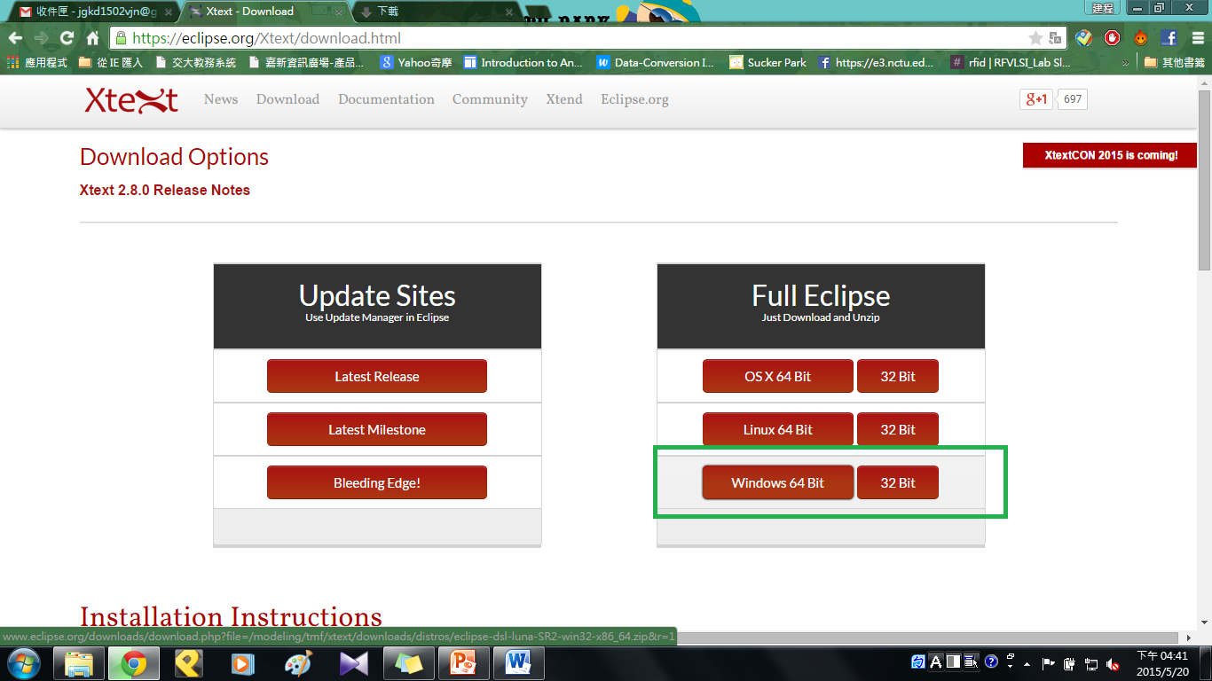
Download Eclipse
https://eclipse.org/Xtext/download.html

Slide 3
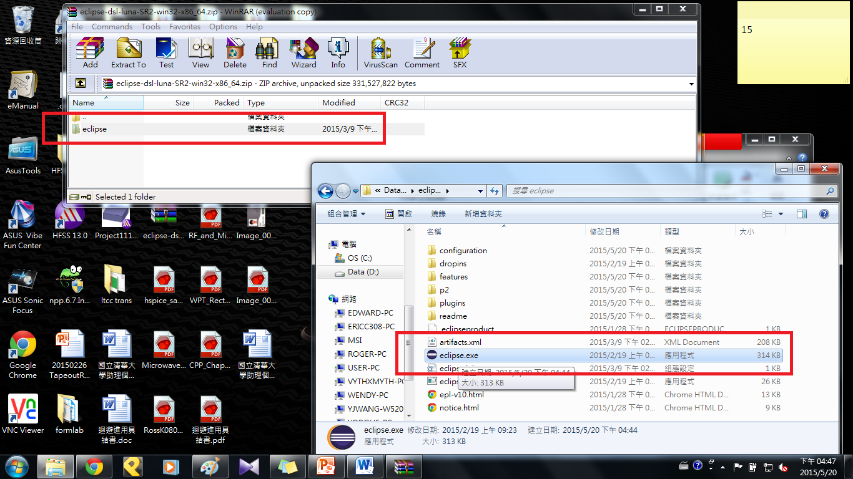
Extract Files

Slide 4
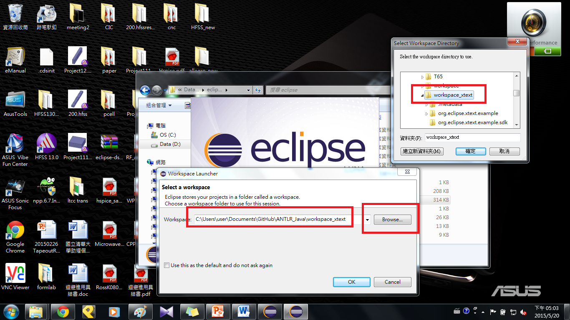
Open Eclipse
Browse → …\GitHub\ANTLR_Java\workspace_xtext

Slide 5
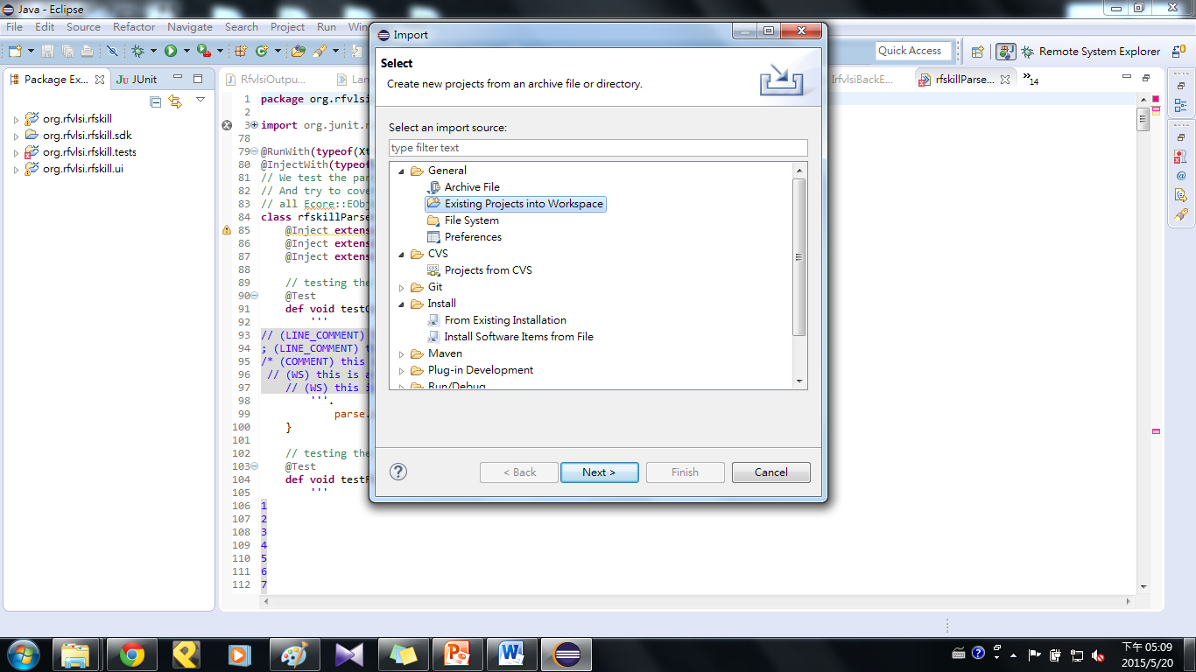
Import File
File → Import → Existing Projects into Workspace

Slide 6
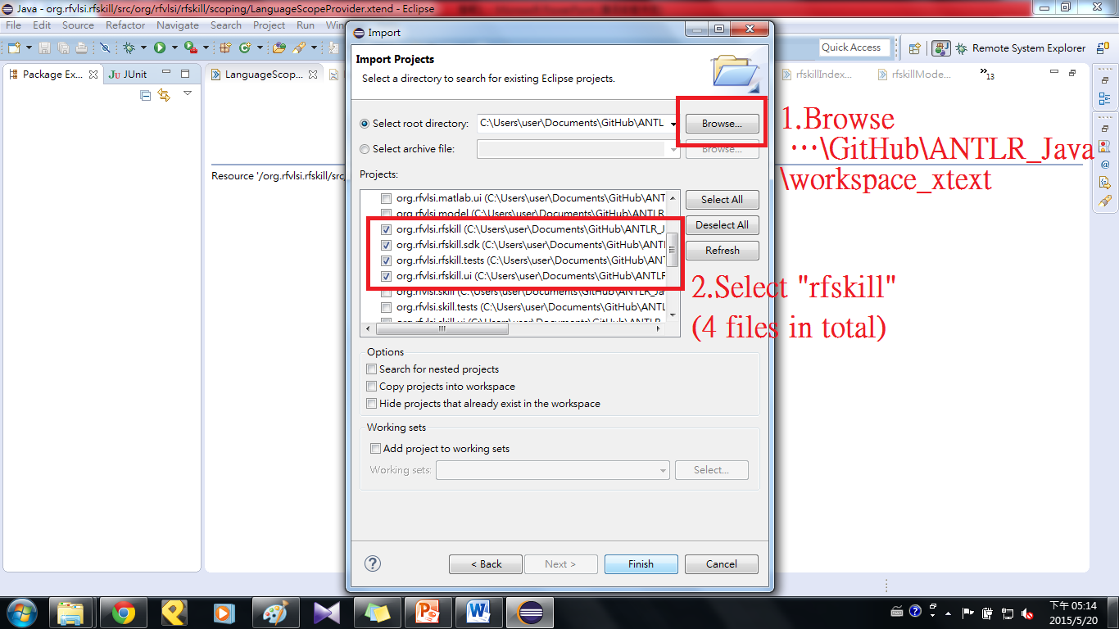
Import Projects

Slide 7
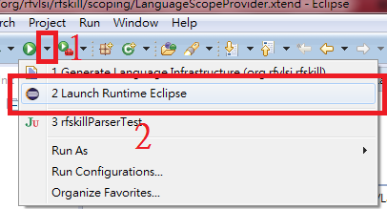
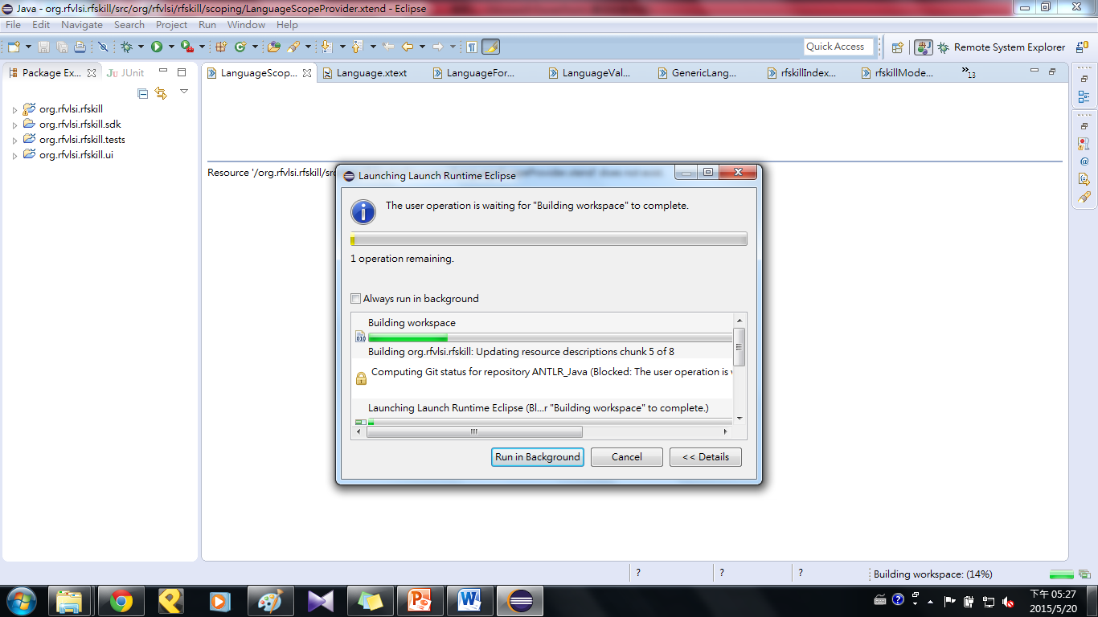
Launch Runtime Eclipse
Click the triangle beside run buttom
→Launch Runtime Eclipse

Slide 8
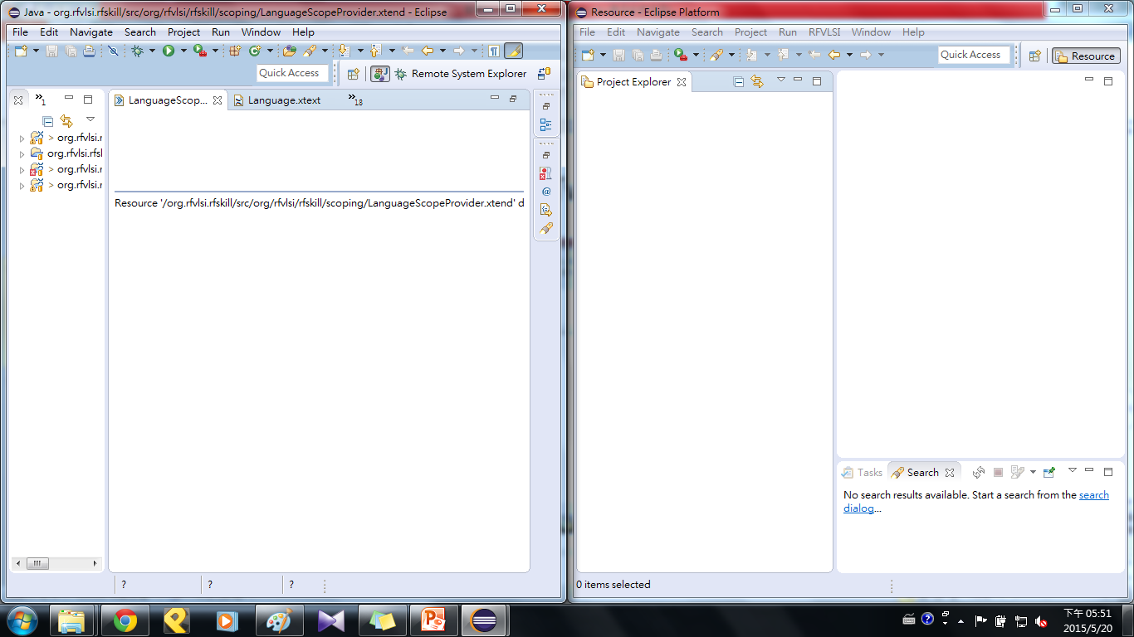
Two Windows

Slide 9
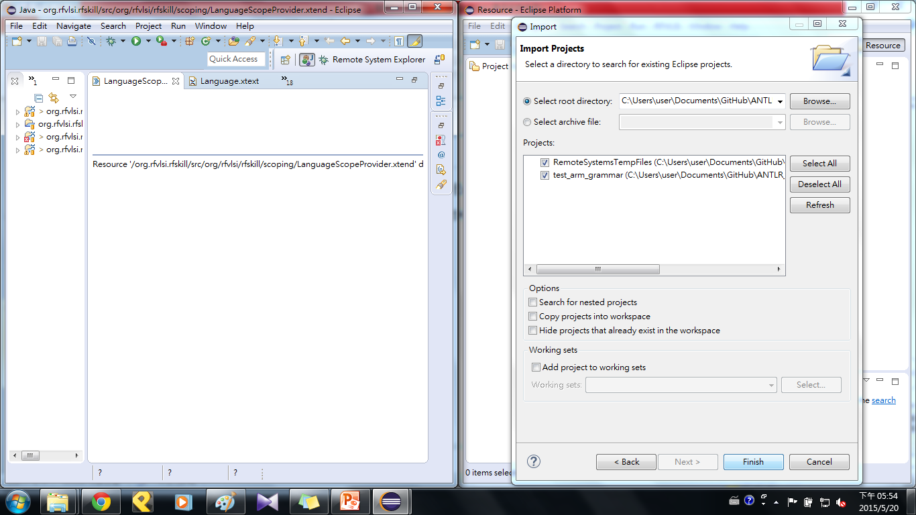
Import Projects
File → Import → Existing Projects into Workspace
Browse → …\GitHub\ANTLR_Java\runtime-EclipseXtext

Slide 10
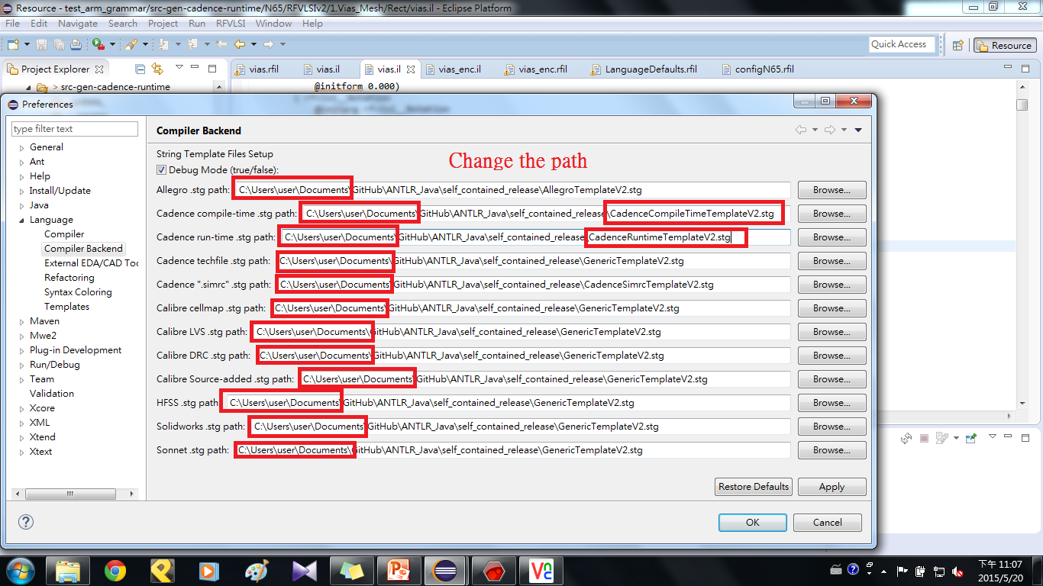
Change The Compiler Backend
Window → preferences → Langrage → Compiler Backend

Slide 11
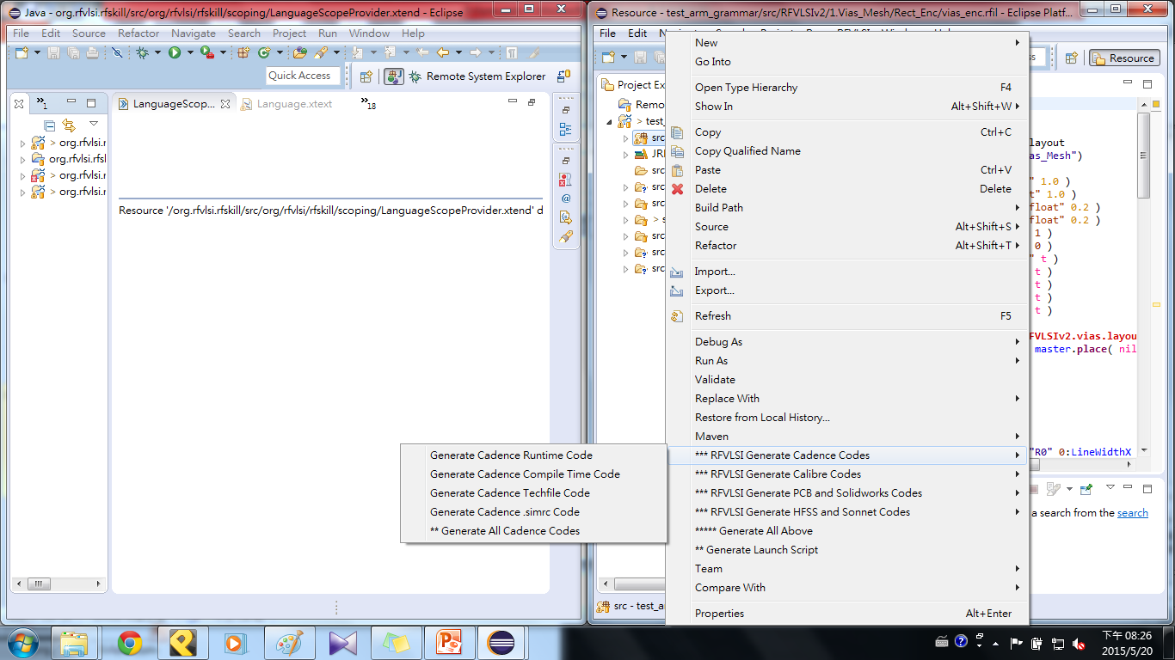
Generate codes
Right click on src → choose generate types

Slide 12
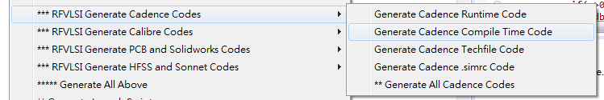
Cadence
Runtime – extract the informations from the layout and provide these informations to compile (like a database)
Compile – compile the codes to create layout.
We generate compile first and then generate runtime.

Slide 13
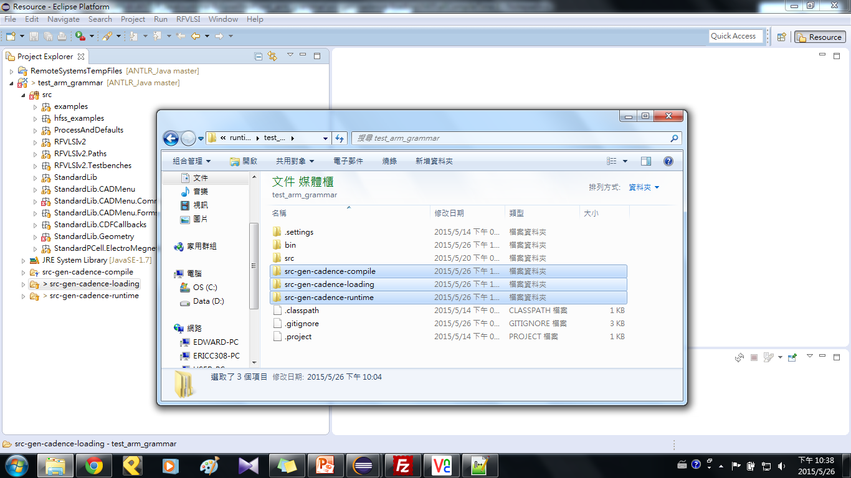
Include the result
Put these three folder ( at …\GitHub\ANTLR_Java\
runtime-EclipseXtext\test_arm_grammar) in your workstation (ex: /home1/jgkd1502vjn)

Slide 14
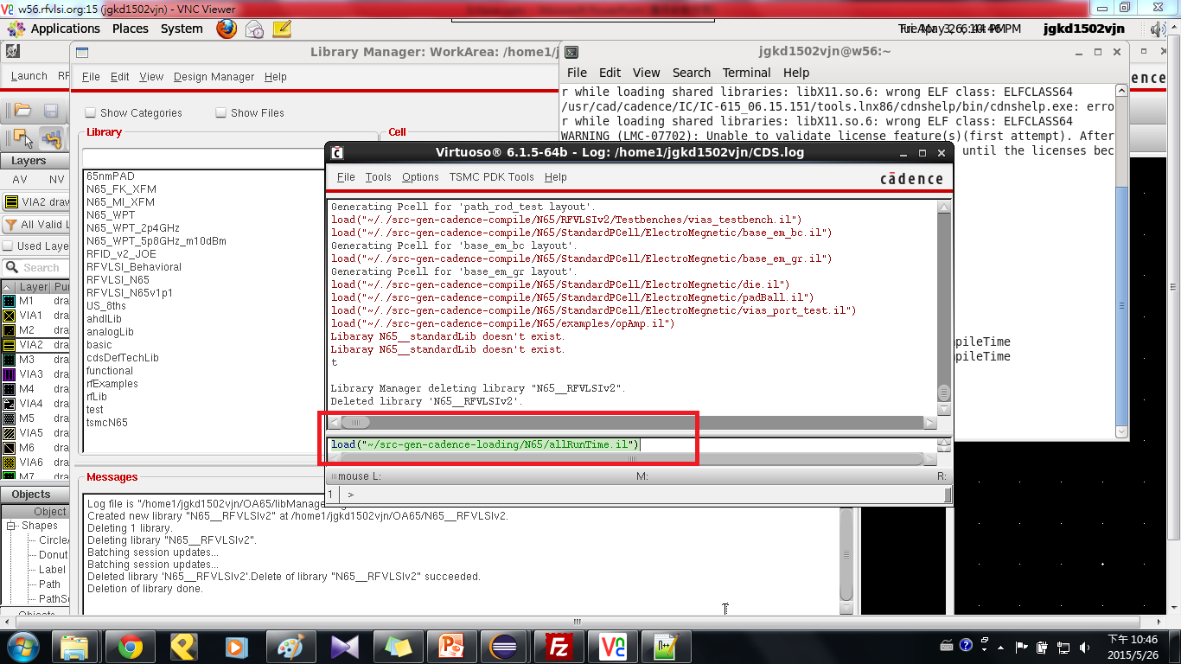
Load runtime

Slide 15
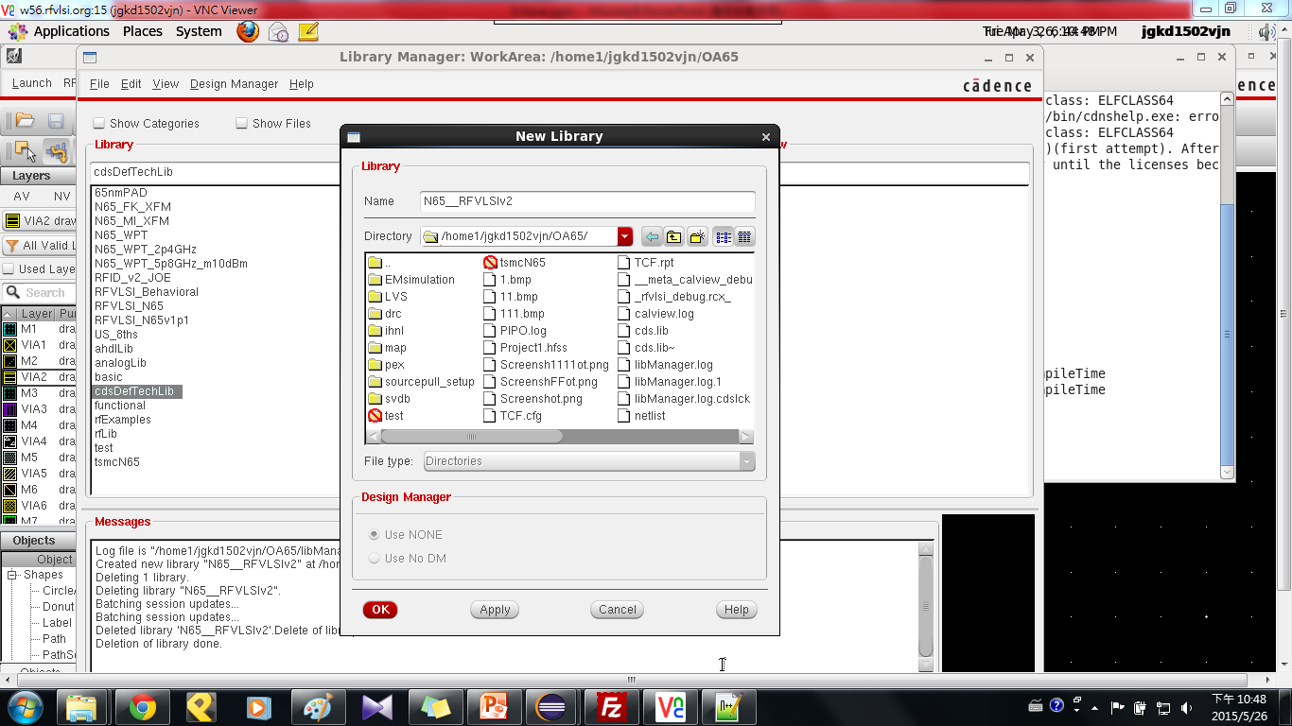
Create new library
Create new library ”N65__RFVLSIv2” (double ”_”)

Slide 16
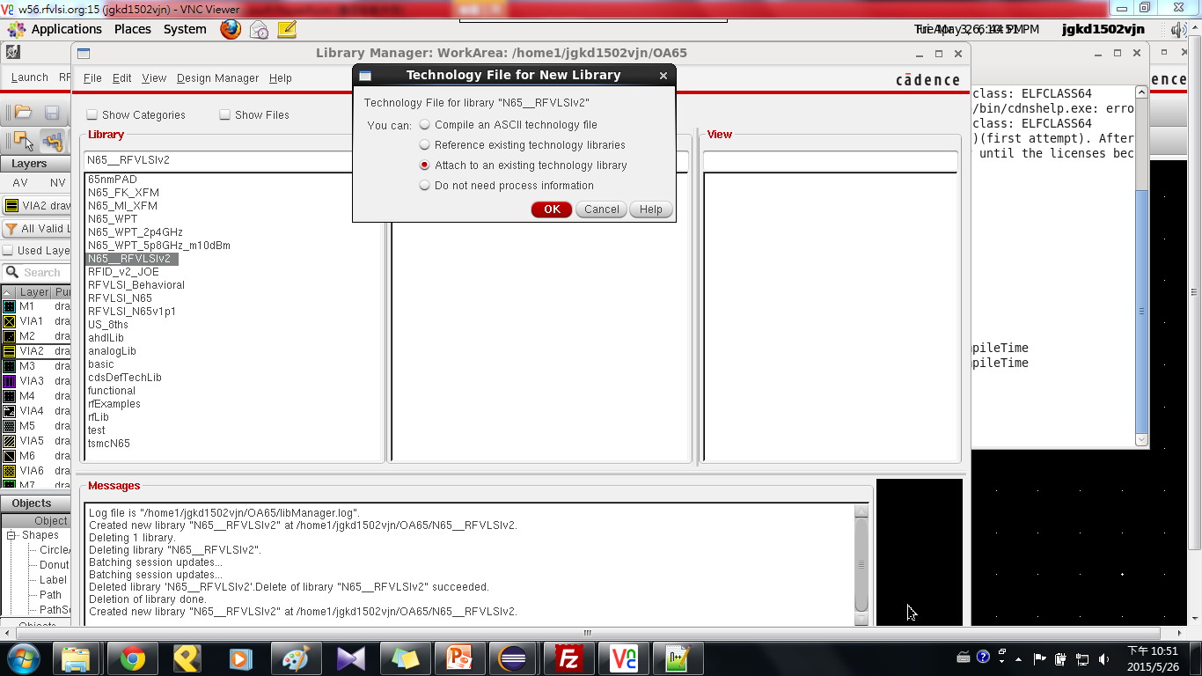
Attach tech file
Attach to an existing techology library → tsmcN65

Slide 17
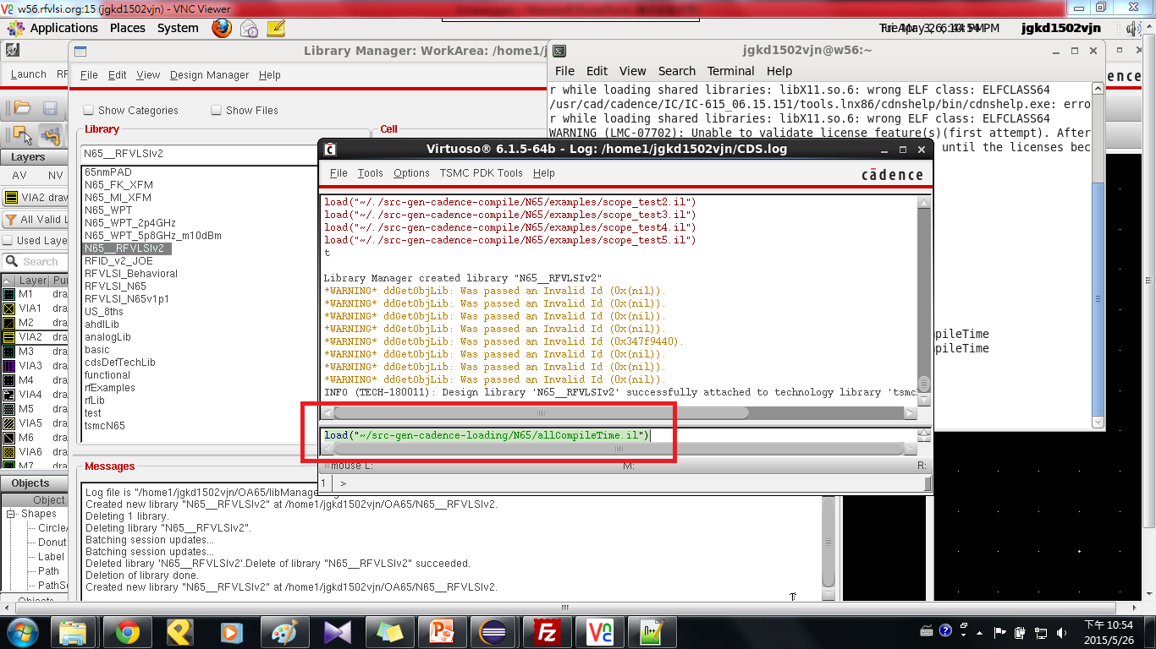
Load compile

Slide 18
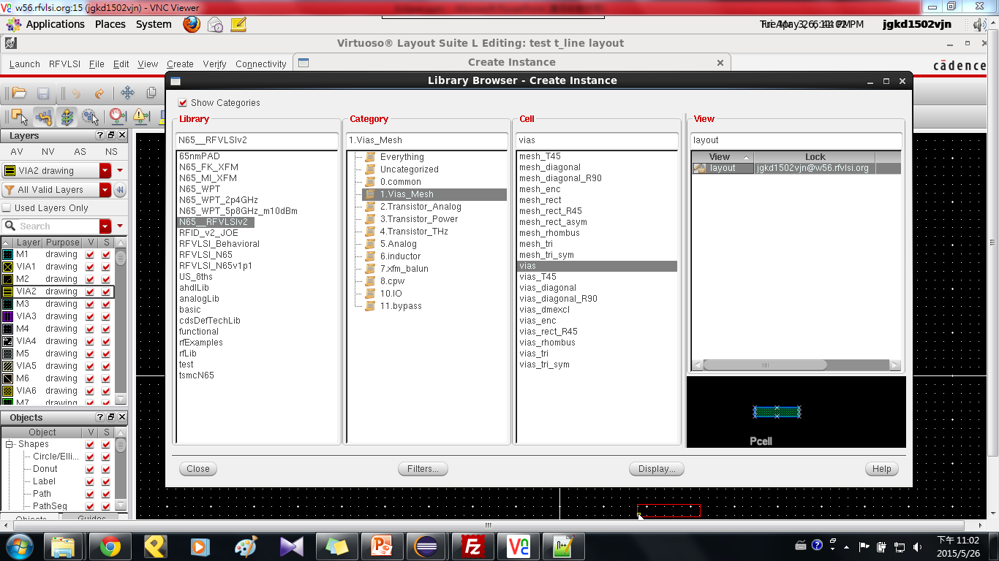
Finish

